Slide 1
Amazon Reviews Sentiment Analysis
Using NLTK & RNN
Github link

Slide 2

Agenda Github link: Amazon reviews sentiment analysis
Introduction
Data cleaning
Exploratory Data Analysis
Processing for NLP analysis
Applying NLTK’s sentiment analysis to the dataset
Balancing the dataset using imblearn and reapplying NLTK’s sentiment analysis
Creating a Recurrent Neural Network for sentiment analysis
Conclusion
This Photo by Unknown Author is licensed under CC BY-SA-NC
This Photo by Unknown Author is licensed under CC BY-SA-NC

Slide 3
Introduction
Amazon is the biggest seller online in present day. One of the best features of Amazon is the product reviews a customer can go through before making a purchase of a particular product. In this project, we are using such customer reviews dataset on amazon products from Kaggle to prepare a model which can understand the sentiment of a review.
In this project we have taken a Kaggle dataset of Amazon product reviews of different products. The dataset consists of labelled 5.6 lakh reviews with details like:
Product ID
User ID
Profile Name
Score
Time of the review
Summary
Text

Slide 4
Title!

Slide 5
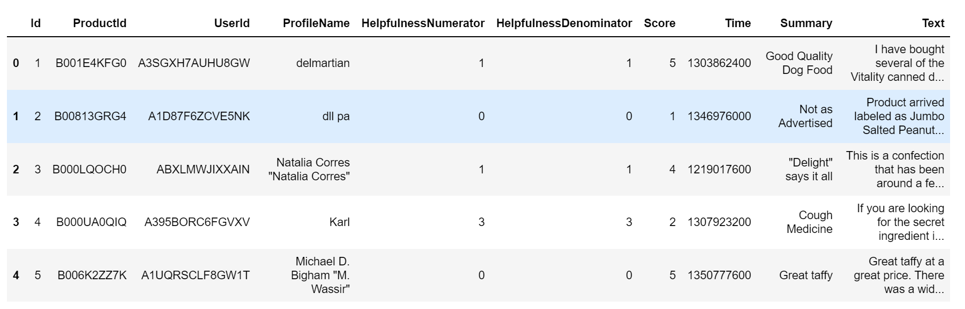
Data cleaning
Shape of the dataset is: (568454 X 10)
We got a few blanks (around 27 overall) in the dataset which we deleted
There were no duplicates found in the dataset

Slide 6
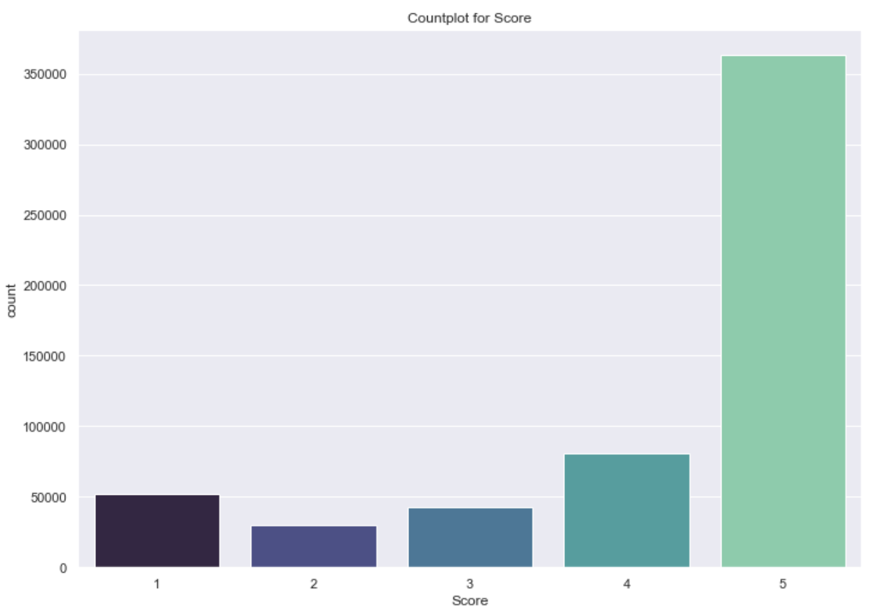
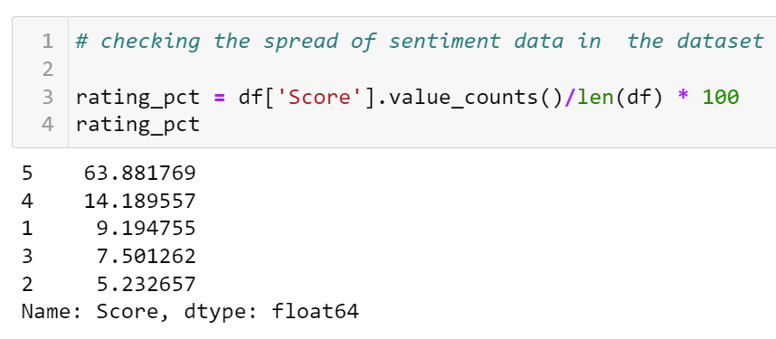
Exploratory Data Analysis
The score column is highly imbalanced
Below is the percentage split of the values from 1 to 5.

Slide 7
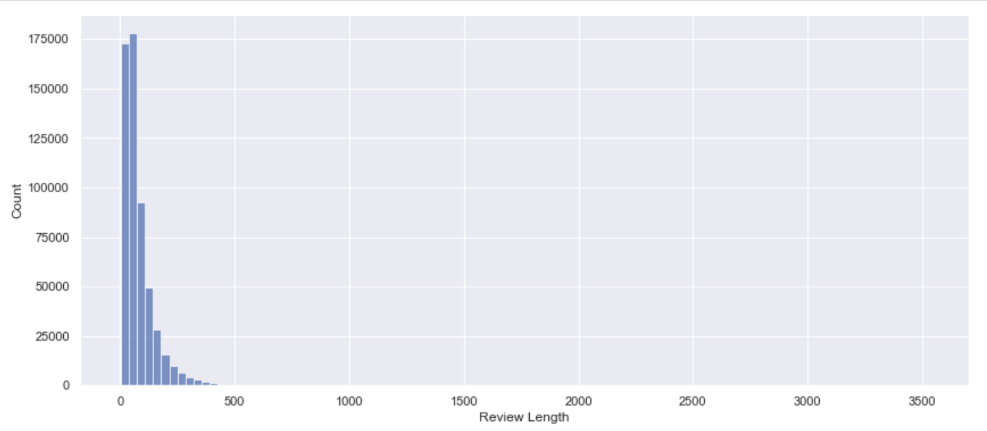
Exploratory Data Analysis
Below we look at the average review length from the dataset.

Slide 8
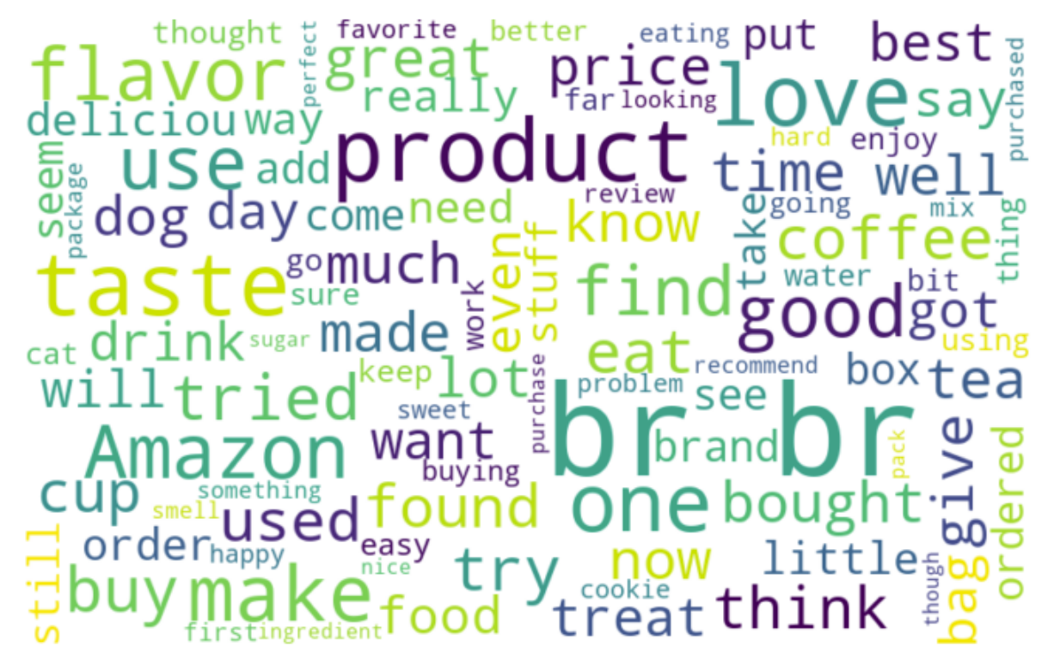
Exploratory Data Analysis
Below we create a wordcloud of the reviews text to see the most commonly used words in the dataset.

Slide 9
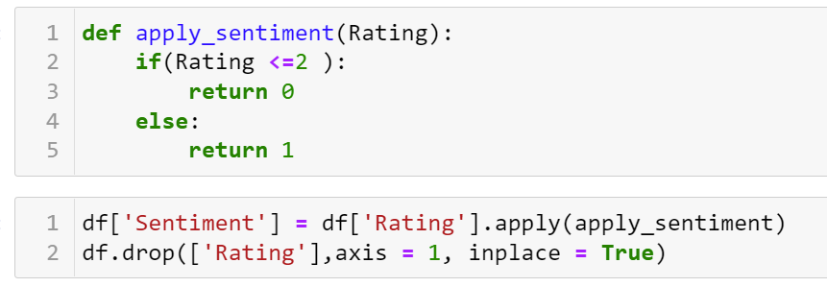
Processing data for NLP analysis
We create a dataframe out of the existing dataframe to have only Score, Text and ID for doing the analysis
We create a function to categorize all scores below 2 as 0 which means they are negative and all scores greater than 2 as positive with a 1.

Slide 10
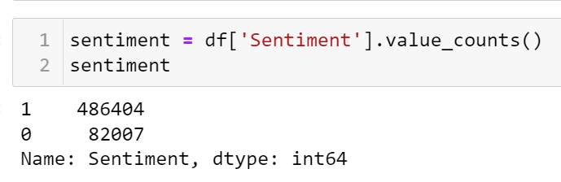
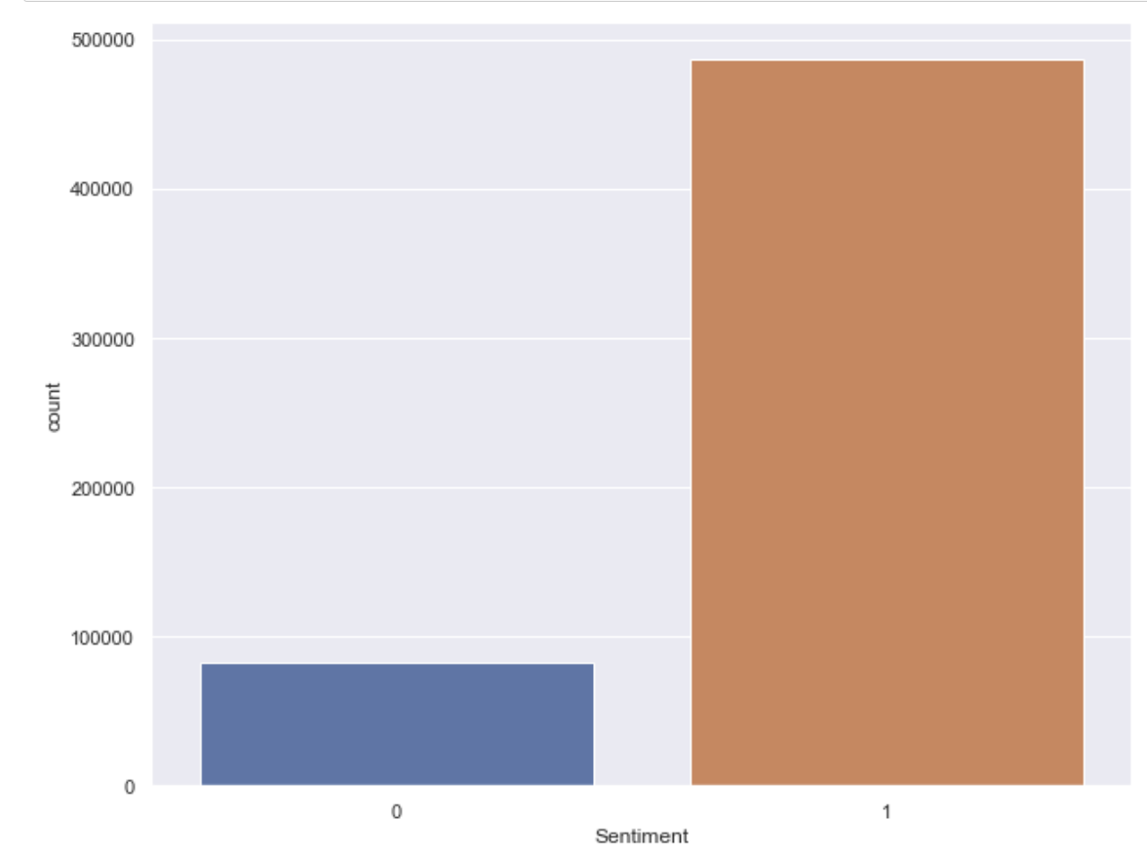
Processing data for NLP analysis
The sentiment class is now categorized not 1 for positive sentiment and 0 for negative sentiment.

Slide 11

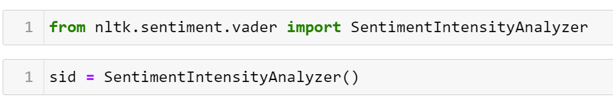
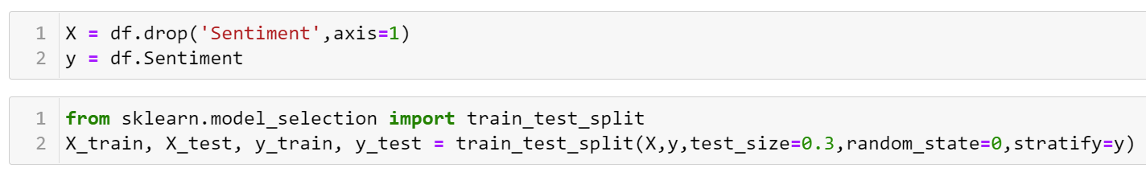
Applying NLTK’s sentiment analysis
We download the NLTK’s ‘vader_lexicon’ for doing the sentiment analysis
We also import the library SentimentIntensityAnalyzer of the nltk.sentiment.vader library
We split the dataframe into X and y and then do the train and test splits for training the model.

Slide 12

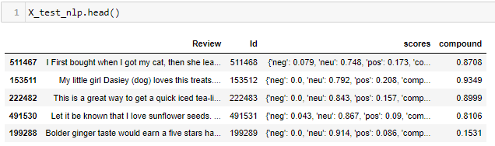
Applying NLTK’s sentiment analysis
We use the Sentiment Intensity Analyzer’s polarity scores method to create the scores for the reviews.
We then use the compound score to categorize the output into 1 for positive and 0 for negative reviews.
We take the Comp_score output and store it in the predict class for testing the accuracy of the model.

Slide 13
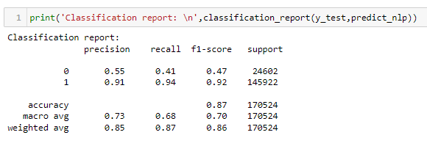
Applying NLTK’s sentiment analysis
We get a very good accuracy score of 87%.
But, on closely observing we get a biased scores for class 1 than class 0 as the score class was highly imbalanced.
We now need to balance the score class to check if we get better score.

Slide 14
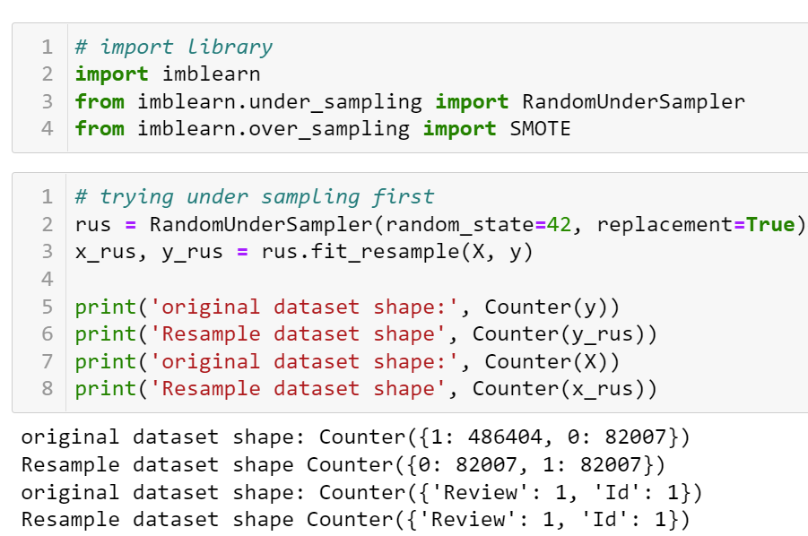
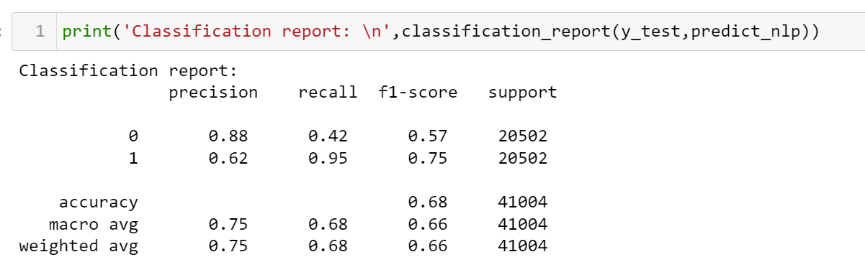
Balancing the dataset and reapplying NLTK’s sentiment analysis
We balance the dataset using RandomUndersampler
This gives us 82007 records for 0 and 1 values in sentiment class
Reapplying the same steps as done above we run the NLTK’s sentiment analysis check on the balanced dataset.
Sadly we get a reduced overall accuracy of 68% but the overall metric scores increase drastically as compared from earlier.

Slide 15
Creating a Recurrent Neural Network for sentiment analysis
Now lets create a RNN network to do the sentiment analysis and see if it gives us better accuracy and other scores.
Before we proceed we create the below functions to do the following:
Clean_text: to clean the text with any special characters apart from alphabets, https etc. and to lower the text field
Remove_punctuation: to remove any punctuation marks in the text field
Remove_html: to remove any https links from the text field
Remove_emoji: to remove any emojis from the text field
Lemmatize_text: to lemmatize the cleaned text
We then remove stop words from the text field to avoid any unnecessary words in the text field

Slide 16
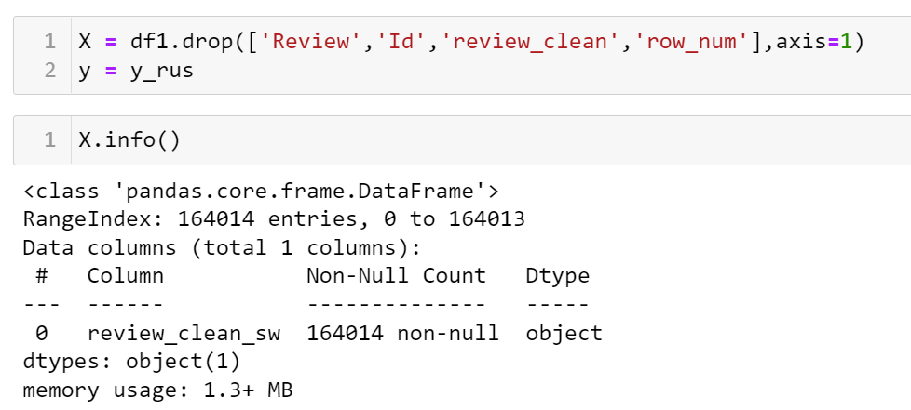
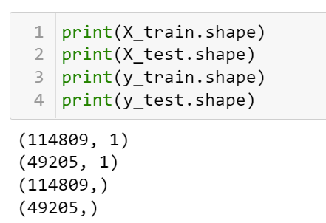
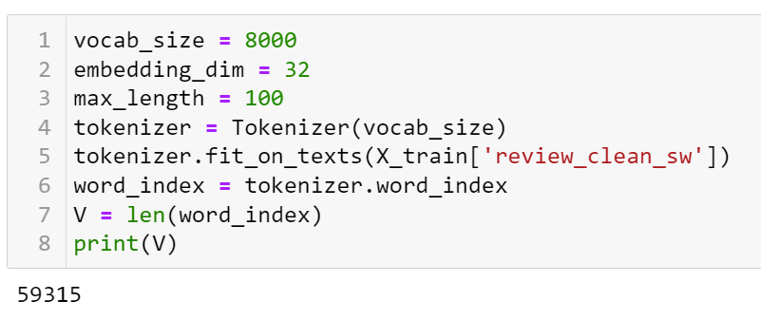
Creating a Recurrent Neural Network for sentiment analysis
Let us split the data set into X and y, where X has the independent variables and y has the target variable.
We then split this dataset into train and test sets.
We then calculate the word index of the target variable for being able to create text to sequences

Slide 17
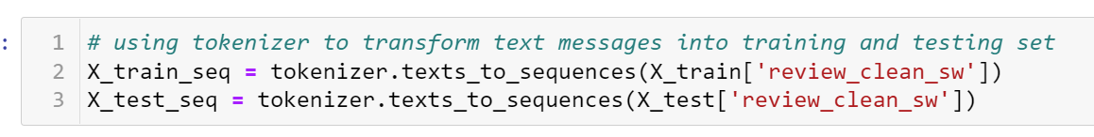
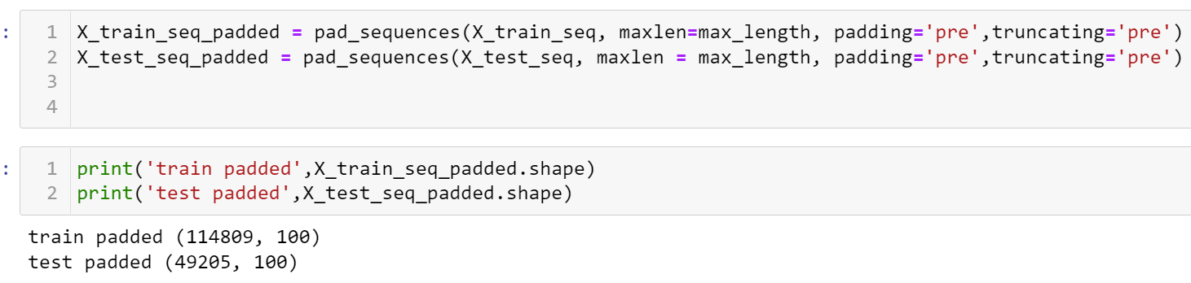
Creating a Recurrent Neural Network for sentiment analysis
We then create text to sequences
After this we create pad sequences

Slide 18
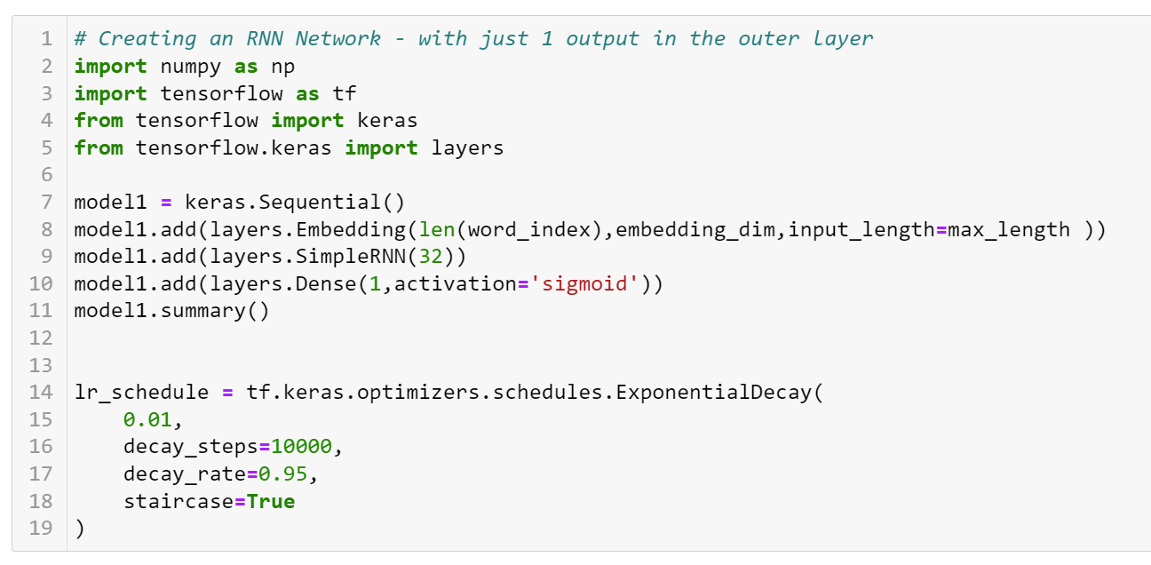
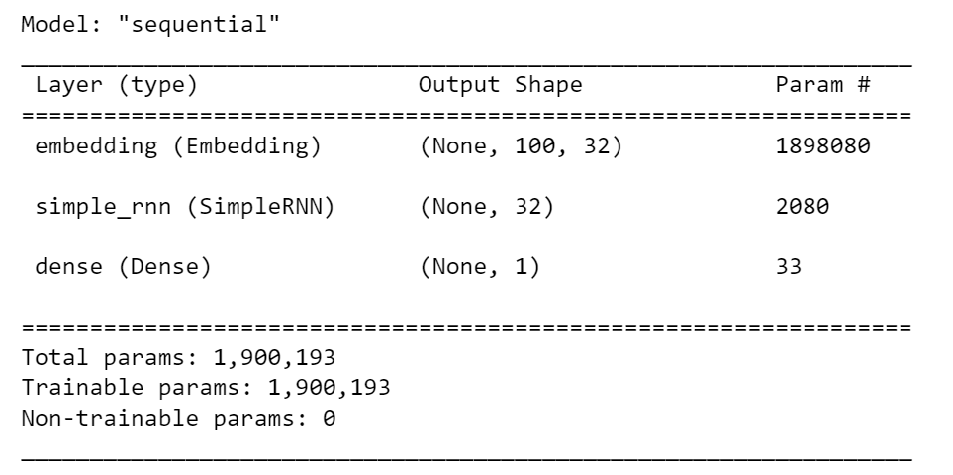
Creating a Recurrent Neural Network for sentiment analysis
We then create the Simple RNN network

Slide 19
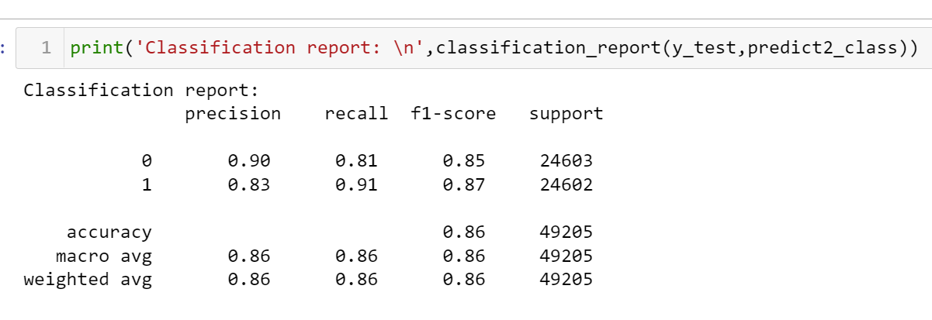
Creating a Recurrent Neural Network for sentiment analysis
We then compile the model and fit it with training dataset and then use the predict function to predict the outcome from the test dataset.
We get an accuracy of 86% by the classification report which has all the other metrics also around the same value.

Slide 20
Conclusion
As we have seen by running the NLTK’s sentiment analysis we go 68% accuracy but by running the same dataset through an RNN network to get the sentiment, we got an accuracy of 86%.

